Slide 1

Data Monetization Strategies
Robert Ruppel, SVP Global Sales

Slide 2

50
+
CONNECT
Enterprise Data Integration
ENTERPRISE DATA EXPERTS
years
MANAGE
Mission-Critical
Data Management
Helping customers manage the world’s most critical data
ANALYZE
High-performance
data analytics
Notes:
Our proven expertise is solving mission-critical data problems for big enterprises.

Slide 3

What is Data Monetization?
Data monetization is the act of generating economic benefits internally, or externally (selling data to third parties) from collected data. It can be used to:
Increase
Revenue
Lower
Costs
Manage
Risks
Notes:
The explosion of information is clearly accelerating. Data is flooding corporate walls and the problem is only getting worse. ​
Data is quickly becoming one of the most critical corporate assets. The challenge most leaders face at this point is how to monetize their ocean of data. Having masses of information is of little value unless it is leveraged to give the company a competitive edge. ​
​

Slide 4

Monetization Starts with Knowing Your Customer
INCREASE SALES
ANALYZE
PROCESSING
MONETIZATION
Optimize Pricing and Promotions
Acquire
and Retain Customers
Improve Forecasting
and Planning
External Monetization
Notes:
Icon and just the stuff in bold delete all the rest​

Slide 5

Robust Solution for the Airline Industry
Customer Case Study
"It’s very reassuring to know that our solution, which keeps airplanes and passengers safe, is backed up by a data solution that has been playing in the ‘premier league’ for so many years.”
Rudi Koffer, Senior Database Software Architect
Lufthansa Systems Airlines Operations Solutions
Notes:
The company licenses the application to other airlines and transportation companies across the world. Lufthansa Systems installs the solution, maintains and updates it in real time to ensure that the airlines have the latest information at their fingertips when they need it. Every time there is a new piece of data or information about a new flight path, a new flight restriction, an airport closure or severe turbulence on the horizon, Lufthansa Systems feeds this via LidoFlight Planning to its customers, helping to ensure that airlines and pilots en route can get their passengers and their cargo safely to their destinations. By calculating cost-optimal flight routes, LidoFlight guarantees to generate millions of dollars in extra revenue for its customers annually. And in an ever-turbulent airline industry, airlines must ensure that their operations run as smoothly and cost-efficiently as possible. This is made possible thanks to the underlying Ingres database that powers LidoFlight Planning.​
​

Slide 6

There's no getting around it...
Data monetization requires trusted data sharing, which requires a trusted data platform
Notes:
Your cloud data platform should provide flexibility with a deploy-anywhere architecture. For example, you can eliminate vendor lock-in with a cloud platform that provides hybrid and multi-cloud deployment options and gain greater control of sensitive data with on-premises support. ​
The cloud makes it easier to facilitate connectivity among locations spread across the world. ​
Cloud elasticity provides the ability to grow or shrink CPU, memory, and storage resources to adapt to the changing demands of an organization. ​
Operating in the cloud improves scalability and performance and removes capacity constraints for dynamic data monetization workloads. ​
​

Slide 7

Data Monetization
Challenges
Data integration
Hybrid infrastructure
Accessing real time analytics
Current platform does not meet needs
Skills shortages
Privacy, compliance, and regulation mandates
Transition from a cost center to a profit center culture

Slide 8

Impact of Data Silos
Data monetization is enabled through integrating data using a trusted, flexible, and easy-to-use data platform
Incomplete, inaccurate, or
sale data insights
Impacts on
business agility
Reduced
productivity
Notes:
You should look for solutions that support batch integration, real-time streaming data, and enforce data quality standards. ​
While it’s not a necessity that your cloud data platform includes data integration and data quality capabilities, you’ll have greater costs and complexity when sourcing these from multiple vendors. ​

Slide 9

Leverage Real-Time Data and REAL Real-Time Analytics
REAL Real-Time: Customers want what they need at the right time – and that time is right now.
Data monetization is most effective when
it provides access to real-time data.
Technology must deliver REAL, real-time analytics:
Easy, built-in integration and data quality
Executing sub-second queries
REAL
Real-Time
Customers want what they need at the right time – and that time is right now.

Slide 10

Data complexity is making real time analytics harder.

Slide 11

Democratize Data
While Protecting Privacy
How do you democratize data while protecting privacy, complying with regulations, and ensuring ethical use?
Notes:
Simple encryption is not enough. ​
GDPR and other privacy regulations mandate striking a balance between identity protection and value to the user. ​
Data governance techniques, such as column-level and record-level protection and dynamic masking, can help meet these requirements. ​
Make sure your cloud data platform supports these techniques. ​
​

Slide 12

Assess the data you have
Define your goals
Understand privacy and compliance requirements
Develop a data monetization strategy
Invest in data infrastructure and analytics
Promote data monetization efforts
Continuously evaluate and optimize
How do you get started?

Slide 13


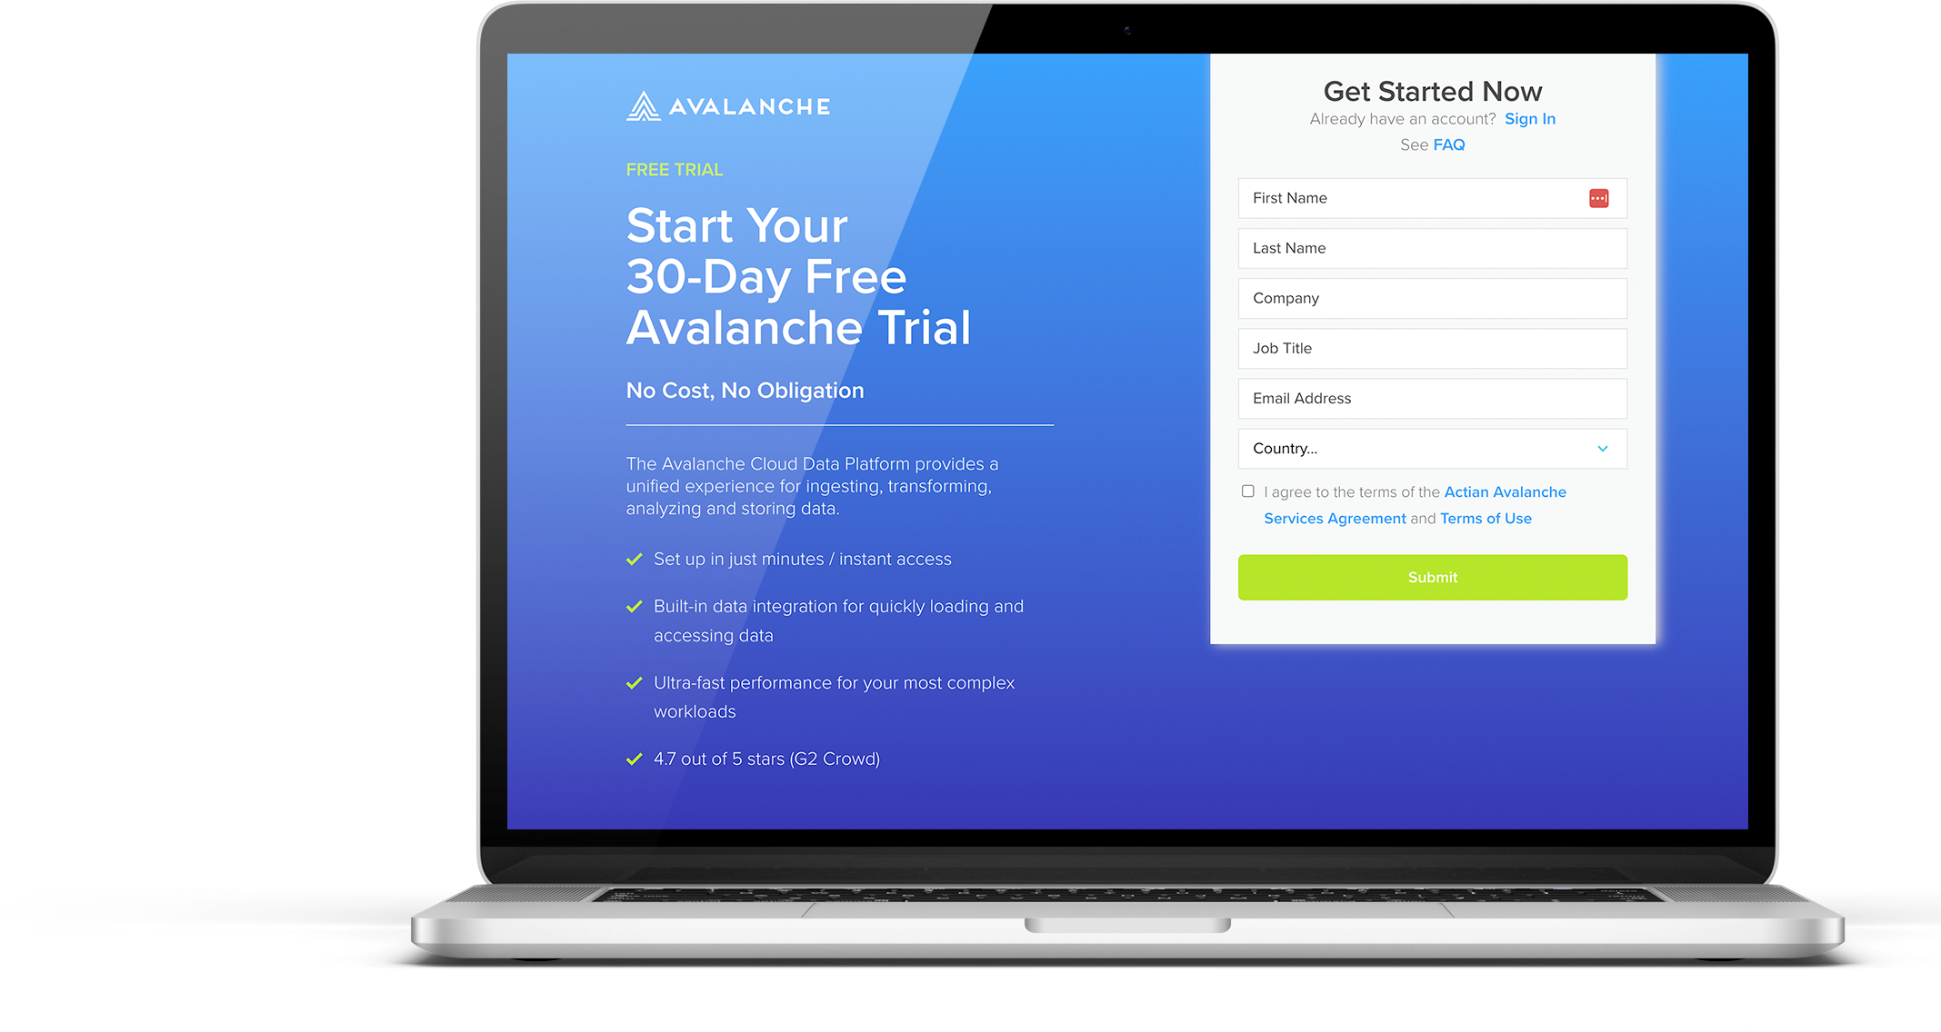
Stop by Booth 4 to continue the conversation

